Slide 1
Self-supervised learning
Part III
元培学院 张铎

Slide 2
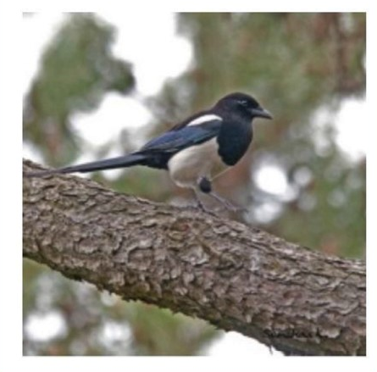
Review
Self-supervised methods we have seen :
Network
Images or videos etc.
Without labels
Large amount
Train the network through auxiliary tasks, such as cropping, rotation, relative place, colorization…

Slide 3
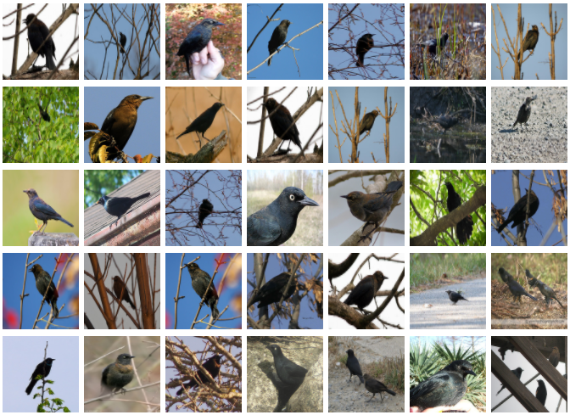
Review
Self-supervised methods we have seen :
Network
Images or videos etc.
Without labels
Large amount
Train the network through auxiliary tasks, such as cropping, rotation, relative place, colorization…
Fine-tune on the labeled data
Small amount

Slide 4
Other methods : more than fine-tune
Multi-task model pipeline:
X. Liu et al. Leveraging Unlabeled Data for Crowd Counting by Learning to Rank
X. Liu et al. Learning from rankings for no-reference image quality assessment
X. Liu et al. Exploiting Unlabeled Data in CNNs by Self-supervised Learning to Rank
Embed task in the model:
Tran et al. Self-supervised GAN: Analysis and Improvement with Multi-class Minimax Game
Method based on suitable prior knowledge or principles:
Samuli et al. High-Quality Self-Supervised Deep Image Denoising
Self-train and meta learning:
Xinzhe Li et al. Learning to Self-Train for Semi-Supervised Few-Shot Classification

Slide 5
Multi-task in Crowd Counting
Target: estimate person number in the given images
Input : an image
Output : the number or crowd density map

Slide 6
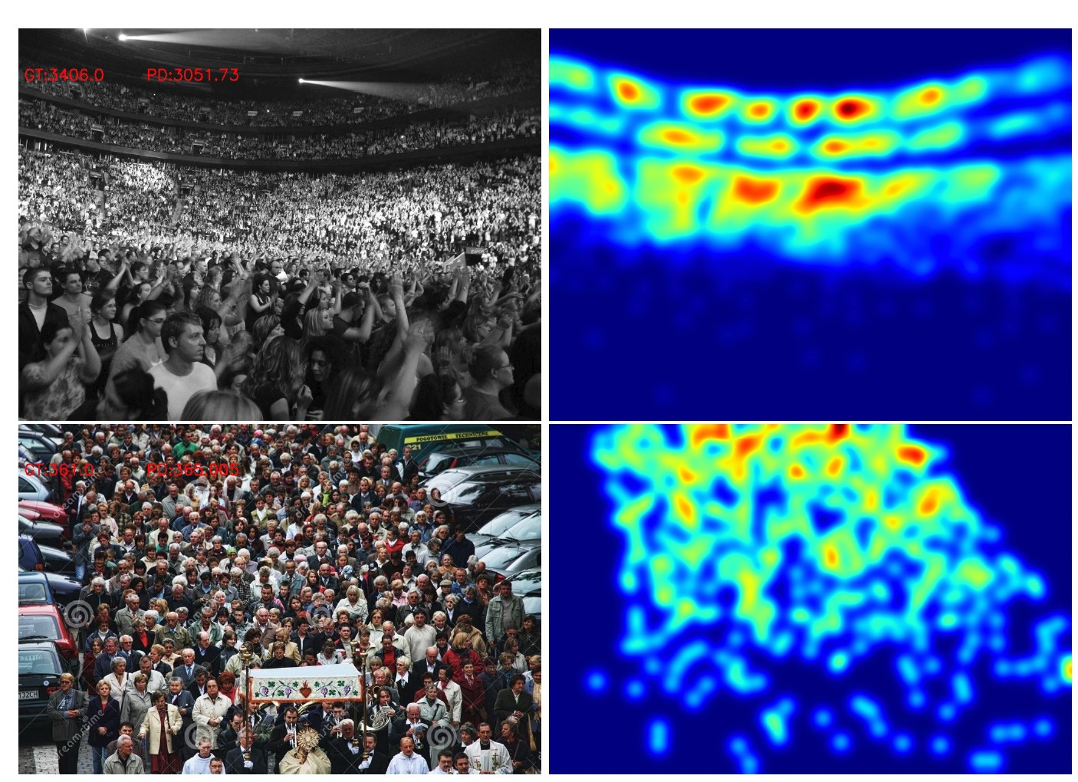
Multi-task in Crowd Counting
Target: estimate person number in the given images
Expensive labeled data: each individual person should be meticulously labeled in training images

Slide 7
Multi-task in Crowd Counting
Target: estimate person number in the given images
Expensive labeled data: each individual person should be meticulously labeled in training images
Self-supervised learning on auxiliary tasks: scaling, cropping, tiling etc

Slide 8
Multi-task in Crowd Counting
Target: estimate person number in the given images
Expensive labeled data: each individual person should be meticulously labeled in training images
Self-supervised learning on auxiliary tasks: scaling, cropping, tiling etc
Drawbacks : task too naïve and fine-tuning may lead to catastrophic forgetting.

Slide 9
Multi-task in Crowd Counting
Learn to rank and multi-task :

Slide 10
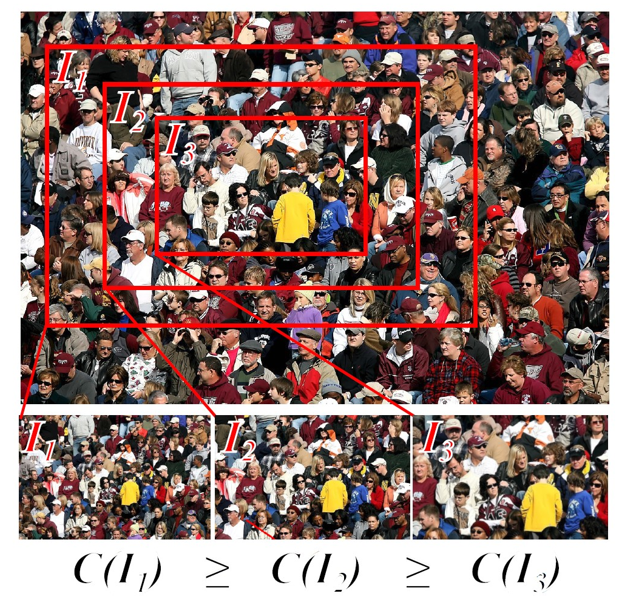
Multi-task in Crowd Counting
Learn to rank and multi-task :
Rank : A new auxiliary task to address the first drawback
Patches contained in patches

Slide 11
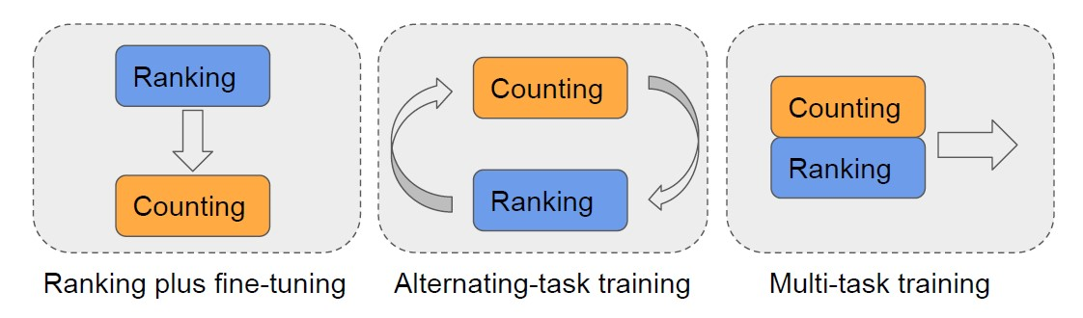
Multi-task in Crowd Counting
Learn to rank and multi-task :
New training pipeline:

Slide 12
Multi-task in Crowd Counting
Learn to rank and multi-task :
New training pipeline:
[1]X. Liu et al. Leveraging Unlabeled Data for Crowd Counting by Learning to Rank

Slide 13
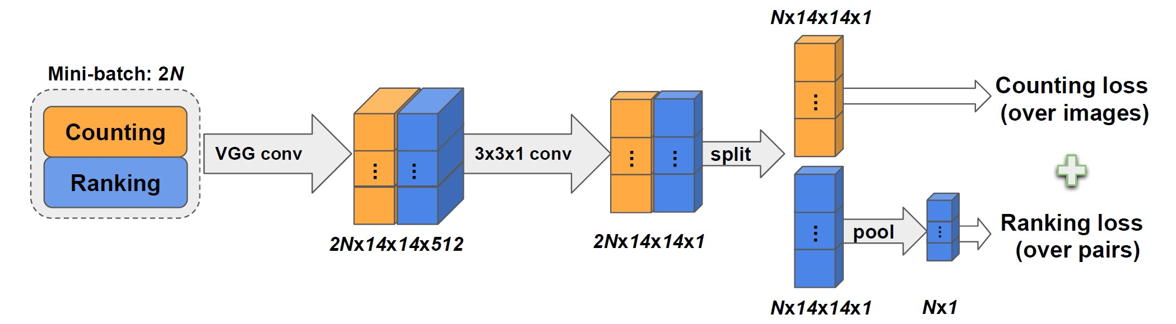
Multi-task in Crowd Counting
Model pipeline:
[1]X. Liu et al. Leveraging Unlabeled Data for Crowd Counting by Learning to Rank

Slide 14
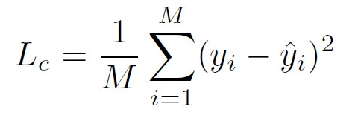
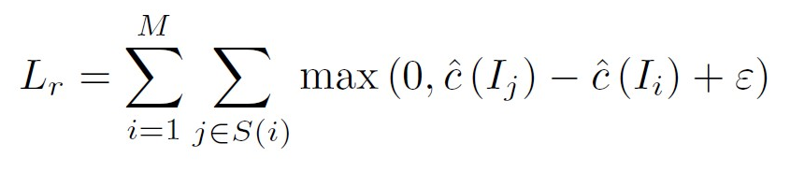
Multi-task in Crowd Counting
Model pipeline:
where S (i) is the set of patches containing fewer people than patch i.
[1]X. Liu et al. Leveraging Unlabeled Data for Crowd Counting by Learning to Rank

Slide 15
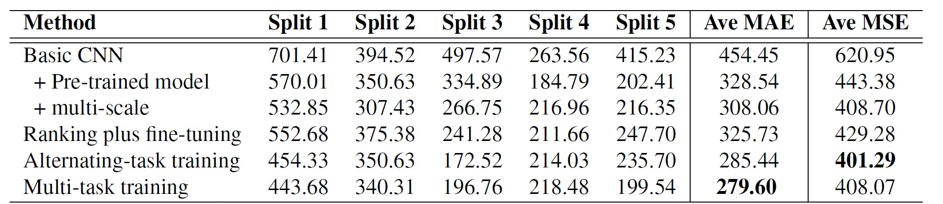
Multi-task in Crowd Counting
Results:
[1]X. Liu et al. Leveraging Unlabeled Data for Crowd Counting by Learning to Rank

Slide 16
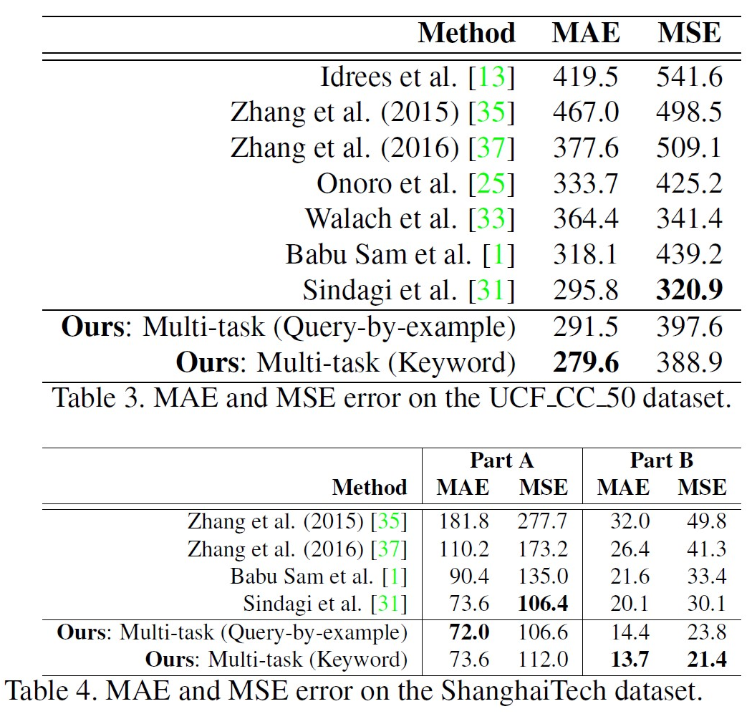
Multi-task in Crowd Counting
Results:
[1]X. Liu et al. Leveraging Unlabeled Data for Crowd Counting by Learning to Rank

Slide 17
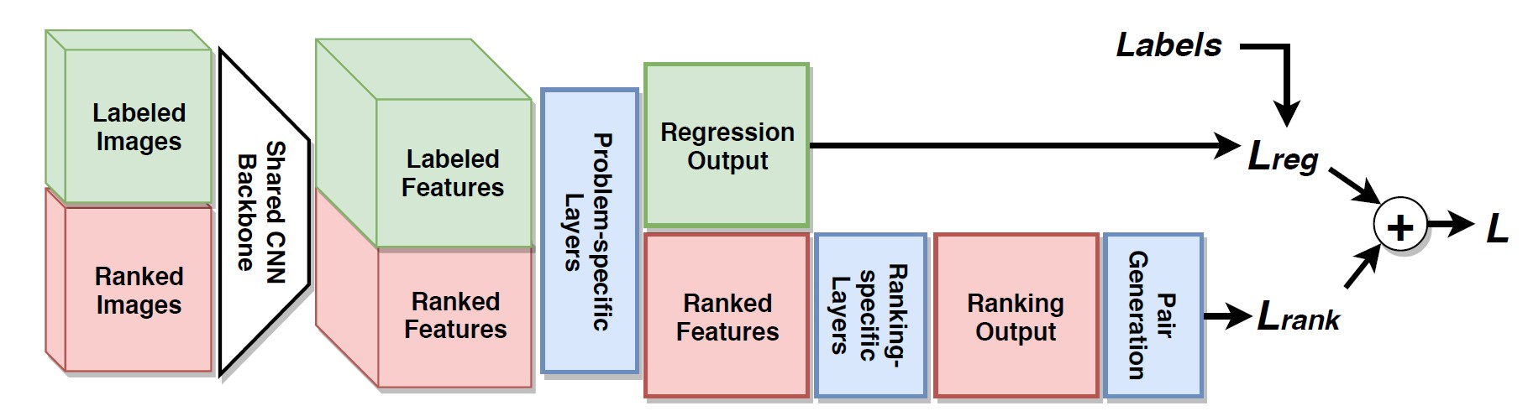
Multi-task model
Other similar tasks such as IQA etc could be performed in this pipeline
[2]X. Liu et al. Learning from rankings for no-reference image quality assessment
[3]X. Liu et al. Exploiting Unlabeled Data in CNNs by Self-supervised Learning to Rank

Slide 18
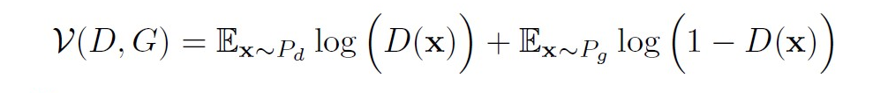
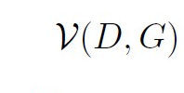
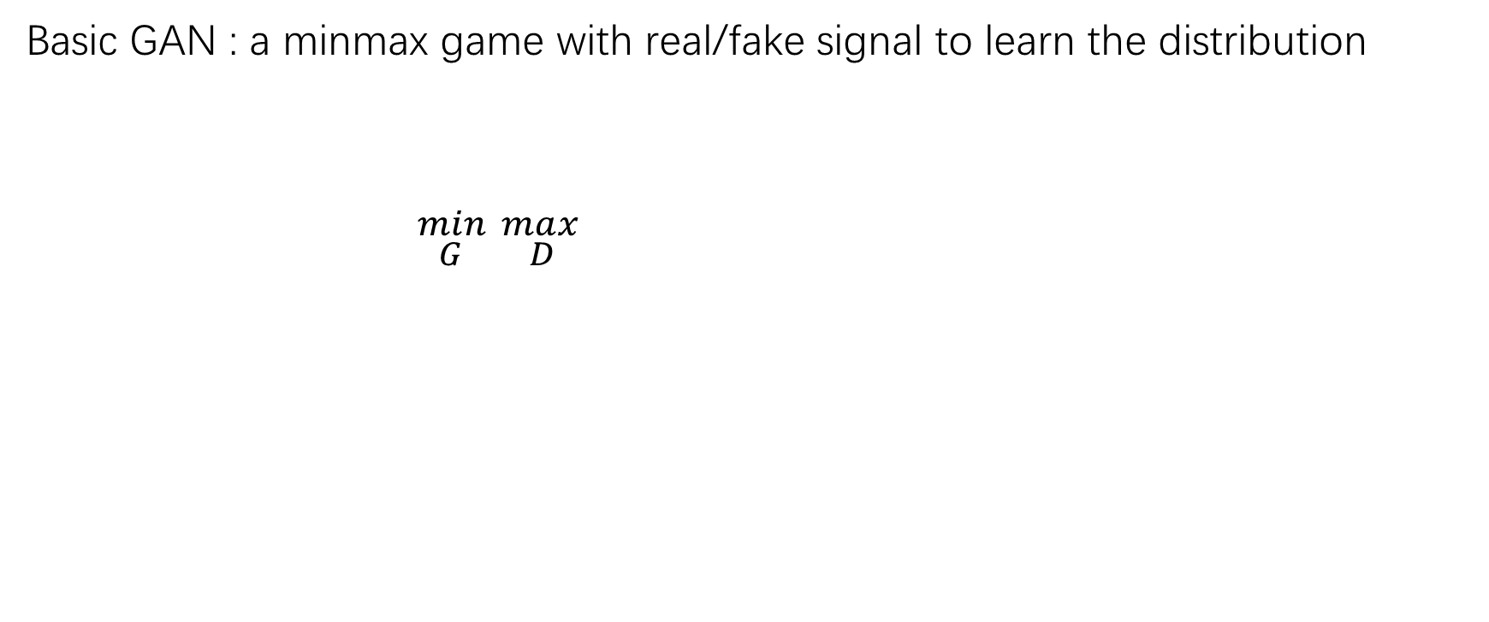
Embed task in GAN
Basic GAN : a minmax game with real/fake signal to learn the distribution
${}_{G }^{min} {}_{D }^{max}{ }$
Problem:
1. catastrophic forgetting
2. Collapsed mode

Slide 19
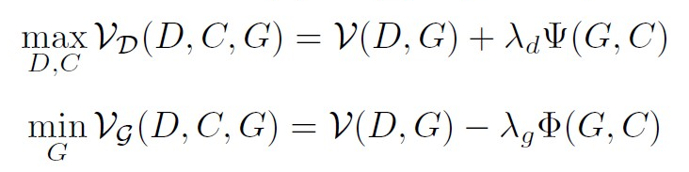
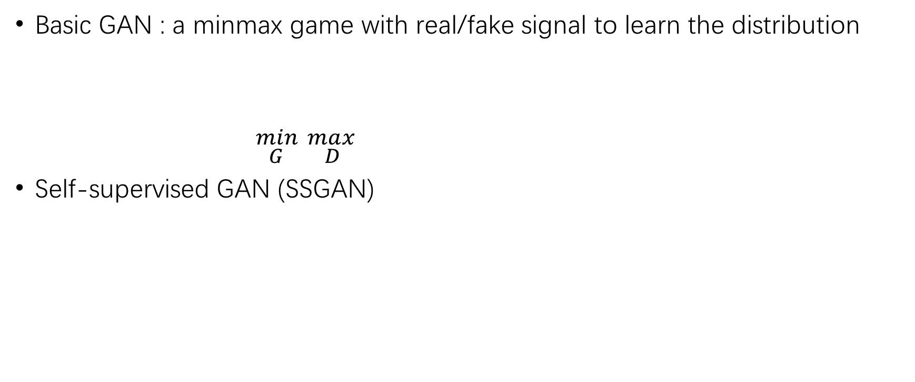
Embed task in GAN
Basic GAN : a minmax game with real/fake signal to learn the distribution
${}_{G }^{min} {}_{D }^{max}{ }$
Self-supervised GAN (SSGAN)
C : Auxiliary classifier

Slide 20
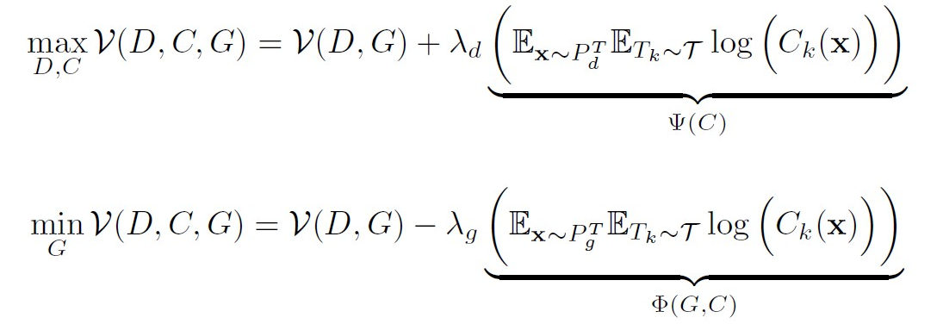
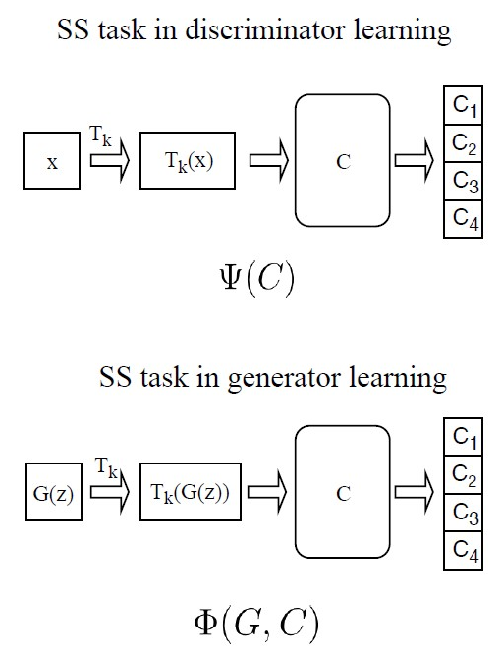
Embed task in GAN
Self-supervised GAN (SSGAN)
More detail:
T : rotations
[4] Ting Chen et al. Self-supervised gans via auxiliary rotation loss. In CVPR, 2019

Slide 21
Embed task in GAN
Analysis on Auxiliary Self-supervised Tasks
SSTask help the Generator
because the Classifier is trained only on the real samples
However the relationship between the task and the Discriminator is not analyzed

Slide 22
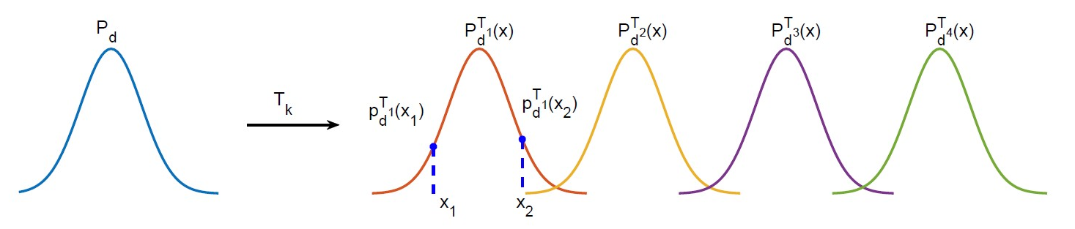
Embed task in GAN
Analysis on Auxiliary Self-supervised Tasks
Mode-collapsed Generator :
$$P_{d}^{T_{k}} is the distribution of sample under transformation T_{k}$$

Slide 23
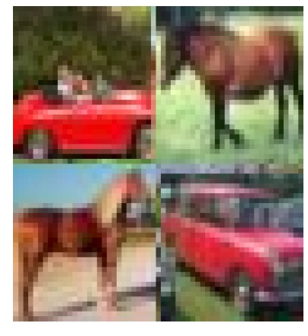
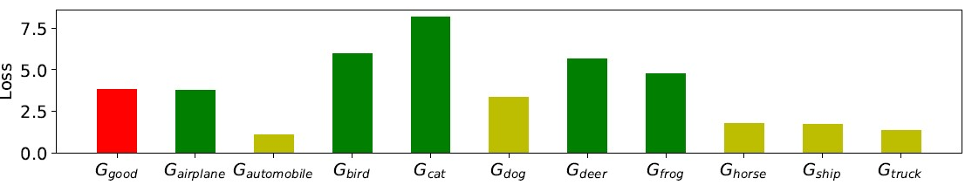
Embed task in GAN
Analysis on Auxiliary Self-supervised Tasks
Mode-collapsed Generator :

Slide 24
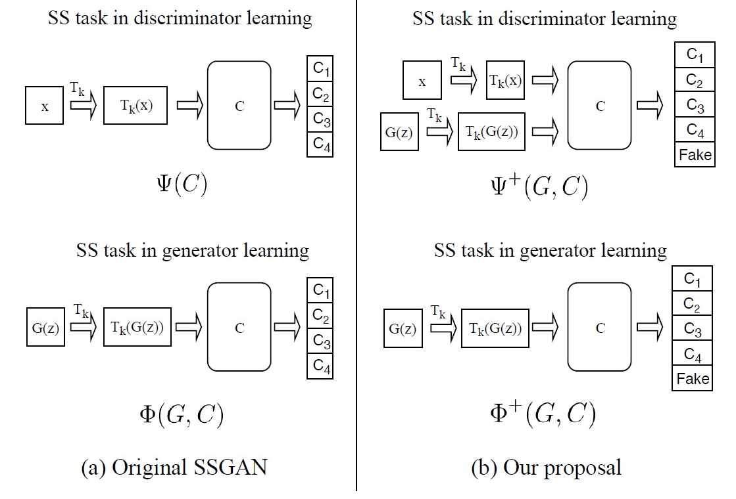
Embed task in GAN
Proposed new SSGAN with multi class minmax game
[5] Tran et al. Self-supervised GAN: Analysis and Improvement with Multi-class Minimax Game,2020
[5] Tran et al. Self-supervised GAN: Analysis and Improvement with Multi-class Minimax Game,2020

Slide 25
Embed task in GAN
Proposed new SSGAN with multi class minmax game
[5] Tran et al. Self-supervised GAN: Analysis and Improvement with Multi-class Minimax Game,2020

Slide 26
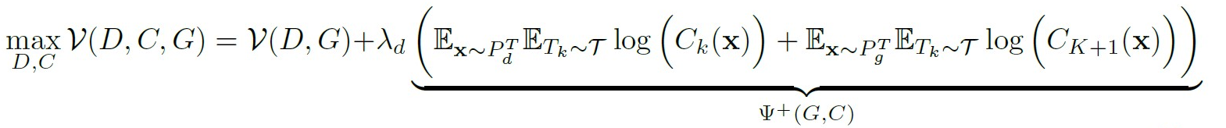
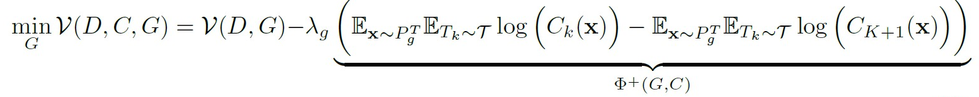
Embed task in GAN
Proposed new SSGAN with multi class minmax game
[5] Tran et al. Self-supervised GAN: Analysis and Improvement with Multi-class Minimax Game,2020

Slide 27
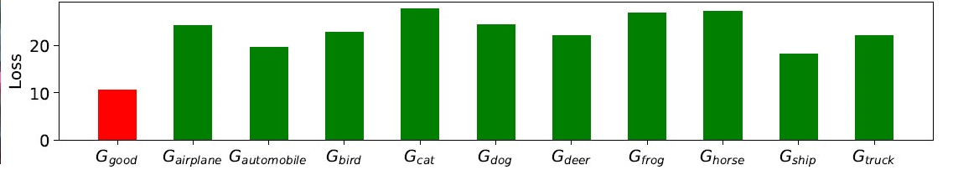
Embed task in GAN
Proposed new SSGAN with multi class minmax game
[5] Tran et al. Self-supervised GAN: Analysis and Improvement with Multi-class Minimax Game,2020

Slide 28
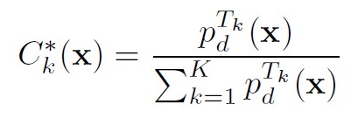
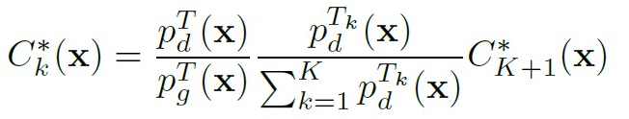
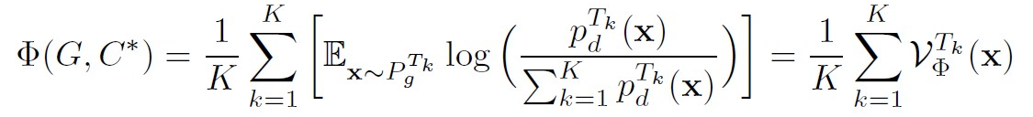
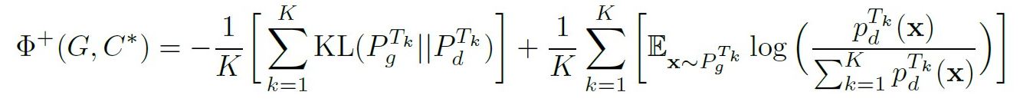
Embed task in GAN
Analytical comparison
Optimal classifier in SSGAN
Optimal classifier in MSGAN
What actually SSGAN optimize
What actually MSGAN optimize
[5] Tran et al. Self-supervised GAN: Analysis and Improvement with Multi-class Minimax Game,2020

Slide 29
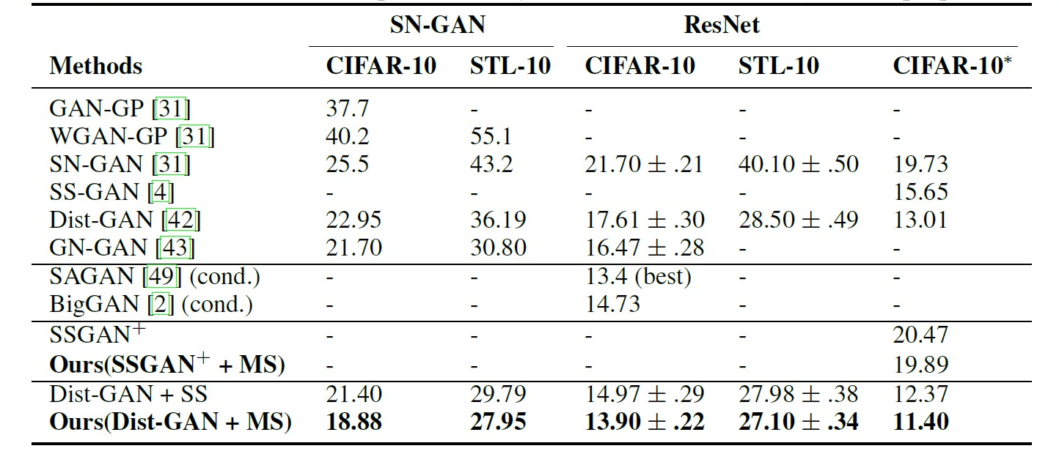
Embed task in GAN
Results:
[5] Tran et al. Self-supervised GAN: Analysis and Improvement with Multi-class Minimax Game,2020

Slide 30
Embed task in GAN
Results:
[5] Tran et al. Self-supervised GAN: Analysis and Improvement with Multi-class Minimax Game,2020

Slide 31
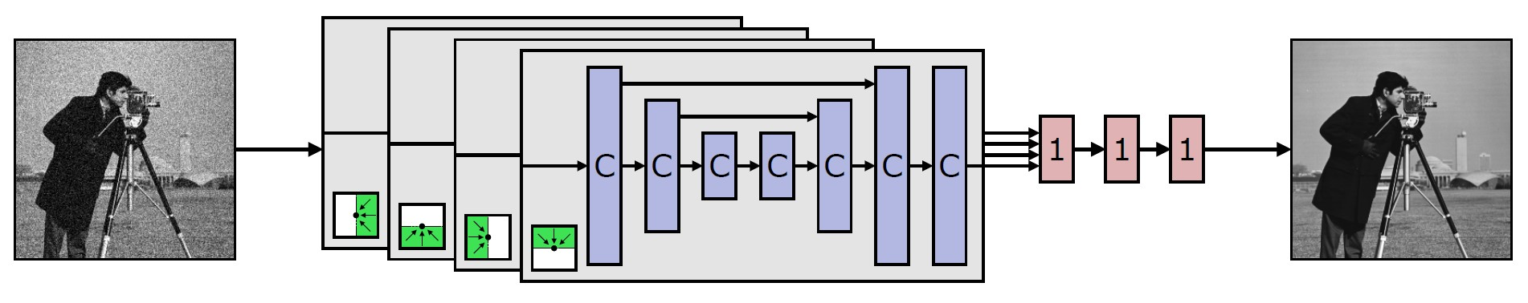
Prior knowledge or principles
Image denoising

Slide 32
Prior knowledge or principles
Image denoising
Traditional method : Noise2Clean
Require paired noisy image : Noise2Noise
(to learn mean in different noise distribution)
Self-supervised: Blindpoint net

Slide 33
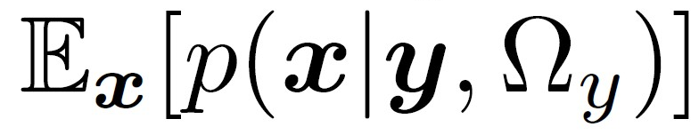
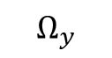

Prior knowledge or principles
$$y$$
Image denoising
Traditional method : Noise2Clean
Require paired noisy image : Noise2Noise
(to learn mean in different noise distribution)
Self-supervised: Noise2Void
$$Ω_{y}$$

Slide 34
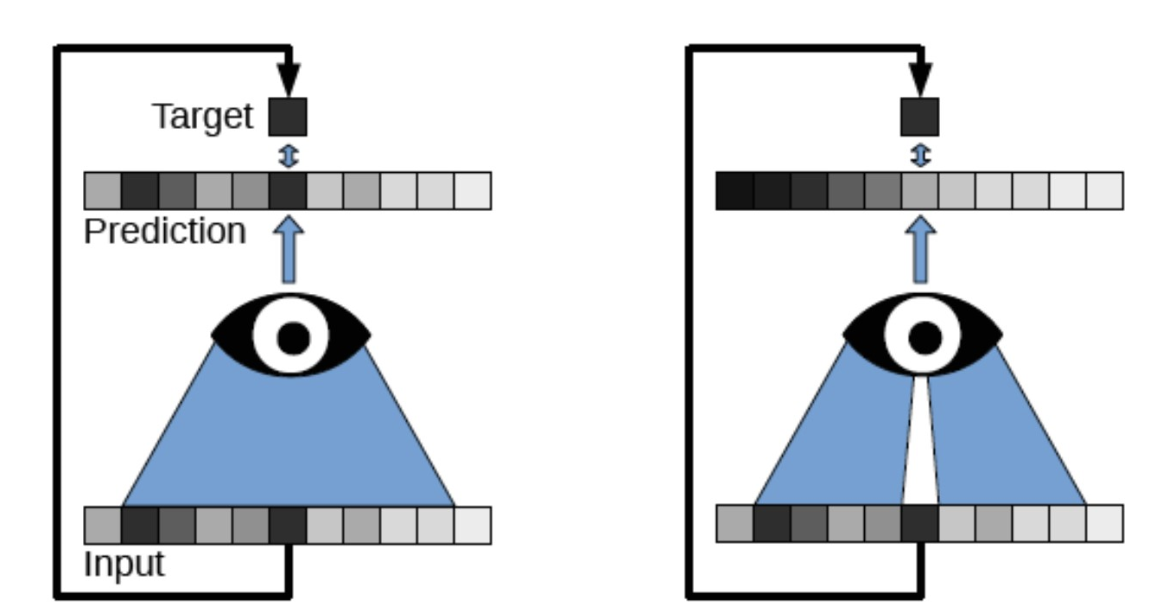
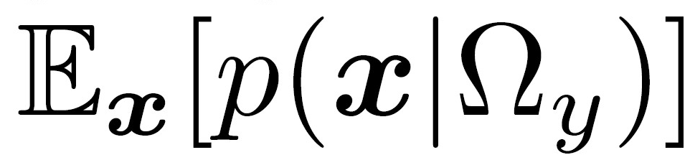
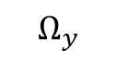

Prior knowledge or principles
Image denoising
Self-supervised: Noise2Void
(ignore the center point in receptive field)
$$y$$
$$Ω_{y}$$
estimate
[6] A. Krull et al. Noise2Void – Learning denoising from single noisy images.

Slide 35
Prior knowledge or principles
Image denoising
Self-supervised: Blindpoint net
Drawback : didn’t use the information of center pixel y in the prediction
$$y$$
$$Ω_{y}$$
estimate
[5] A. Krull et al. Noise2Void – Learning denoising from single noisy images.

Slide 36
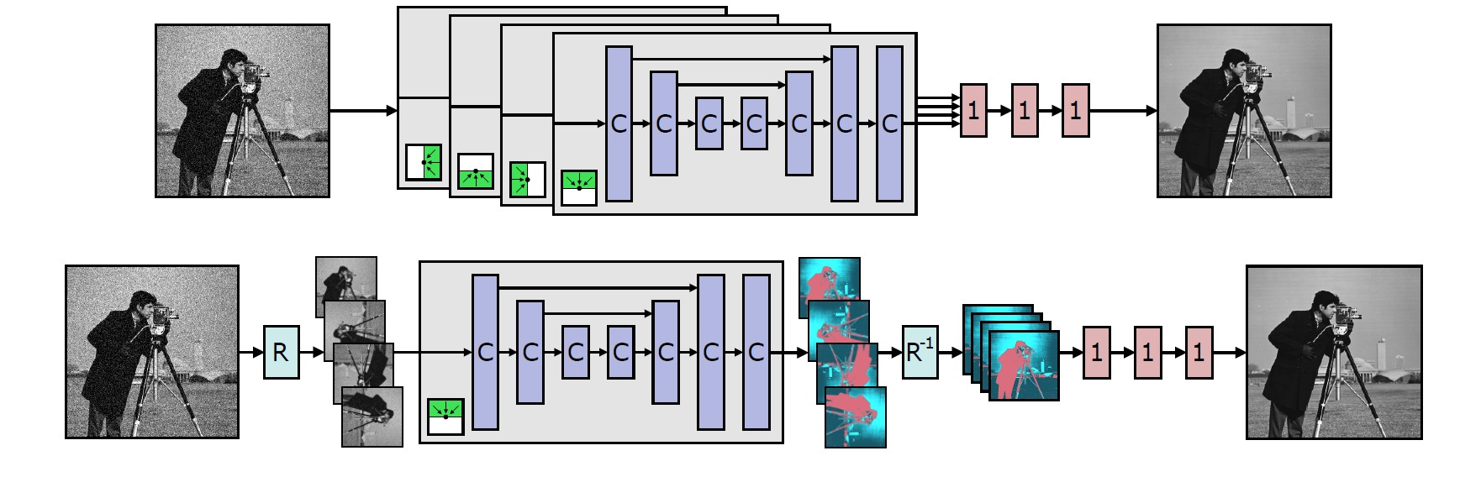
Prior knowledge or principles
Combined Blindpoint net
[7] Samuli et al. High-Quality Self-Supervised Deep Image Denoising, 2019

Slide 37
Prior knowledge or principles
Self-supervised Bayesian denoising with blind-spot networks
[7] Samuli et al. High-Quality Self-Supervised Deep Image Denoising, 2019

Slide 38
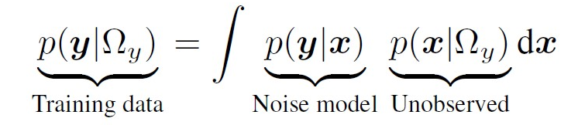
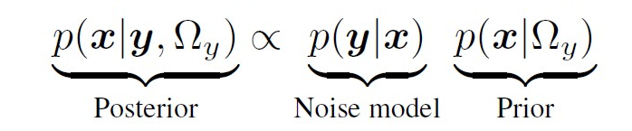
Prior knowledge or principles
Self-supervised Bayesian denoising with blind-spot networks
[7] Samuli et al. High-Quality Self-Supervised Deep Image Denoising, 2019

Slide 39
Prior knowledge or principles
Self-supervised Bayesian denoising with blind-spot networks
With explicit noise model
1. Train the network to estimate by maximizing the similarity
[7] Samuli et al. High-Quality Self-Supervised Deep Image Denoising, 2019

Slide 40
Prior knowledge or principles
Self-supervised Bayesian denoising with blind-spot networks
With explicit noise model
1. Train the network to estimate by maximizing the similarity
2. Use Bayes rules and MAP to choose x that maximize the Posterior
[7] Samuli et al. High-Quality Self-Supervised Deep Image Denoising, 2019

Slide 41
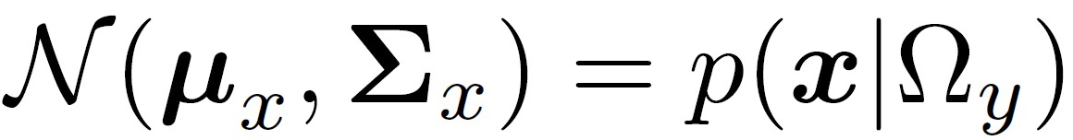
Prior knowledge or principles
Self-supervised Bayesian denoising with blind-spot networks
With explicit noise model
Assume the prior distribution to be a multivariate Gaussian
The covariance matrix
The network output
[7] Samuli et al. High-Quality Self-Supervised Deep Image Denoising, 2019

Slide 42
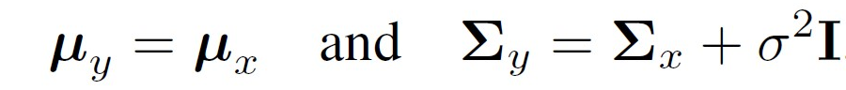
Prior knowledge or principles
Self-supervised Bayesian denoising with blind-spot networks
With explicit noise model
Use different noise models
Additive Gaussian
Final output:
[7] Samuli et al. High-Quality Self-Supervised Deep Image Denoising, 2019

Slide 43
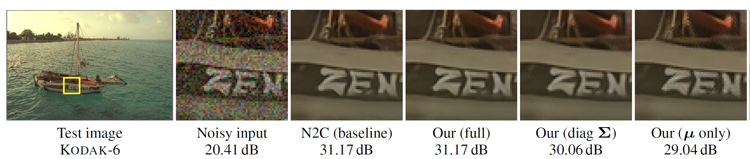
Prior knowledge or principles
Self-supervised Bayesian denoising with blind-spot networks
With explicit noise model
[7] Samuli et al. High-Quality Self-Supervised Deep Image Denoising, 2019

Slide 44
Self-train and meta learning
Self-train in few-shot classification
1.Train on the support dataset (labeled but few)
Loop:
2.Predict the unlabeled data, and choose the most confident ones(with Pseudo-label), and add them into the training set
3.Train the model on the enlarged new dataset

Slide 45
Self-train and meta learning
Meta learning with optimize method
Train a meta-learner to help the learner adapt the new tasks
Input: different episodes(different small dataset contained few labeled and more unlabeled for both train and test)
Use the test loss to optimize the meta-learner

Slide 46
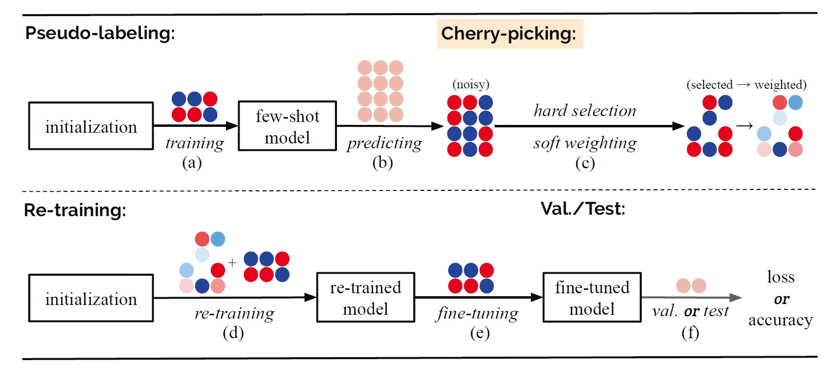
Self-train and meta learning
Combine self-train and meta-learning with a cherry-picking method:
[8] Xinzhe Li et al. Learning to Self-Train for Semi-Supervised Few-Shot Classification

Slide 47
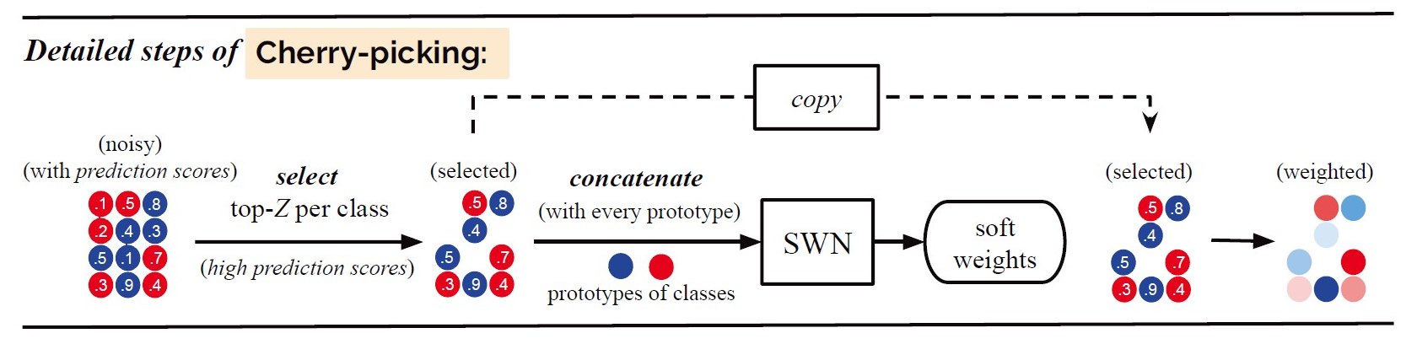
Self-train and meta learning
Combine self-train and meta-learning with a cherry-picking method:
[8] Xinzhe Li et al. Learning to Self-Train for Semi-Supervised Few-Shot Classification

Slide 48
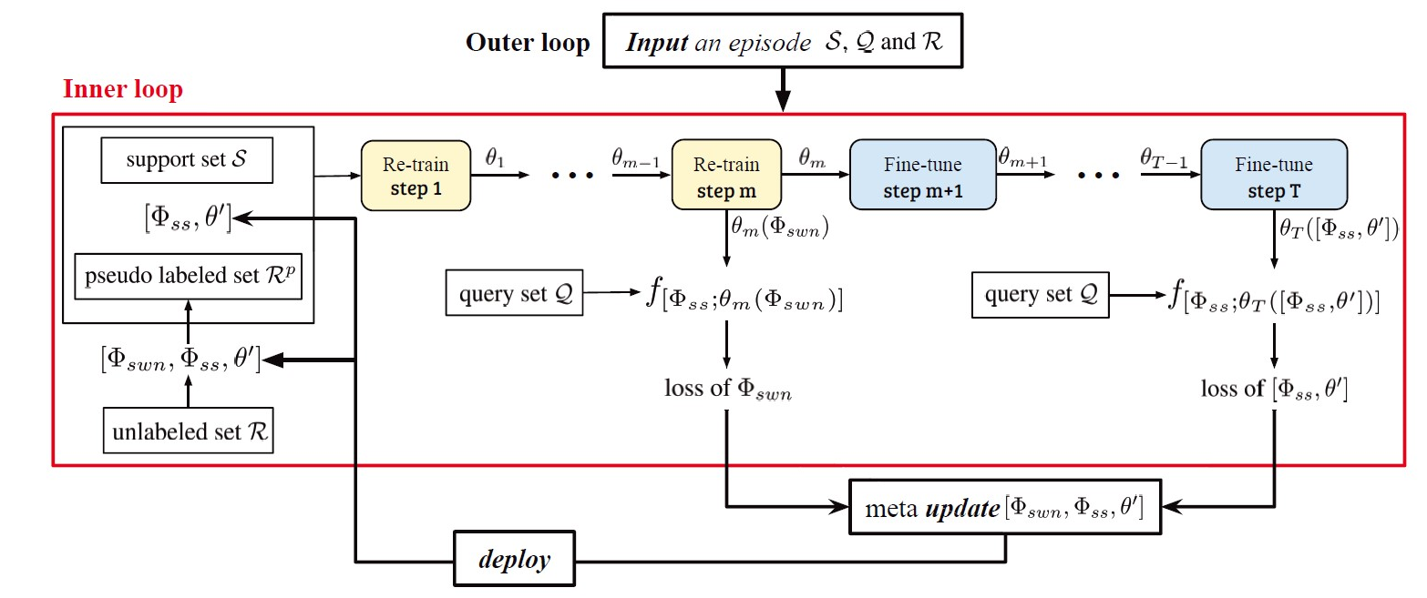
Self-train and meta learning
Combine self-train and meta-learning with a cherry-picking method:
[8] Xinzhe Li et al. Learning to Self-Train for Semi-Supervised Few-Shot Classification

Slide 49
Conclusion on self-supervised learning
Auxiliary task :
easy and uninterpretable delicate and interpretable
Role played by the auxiliary task :
fine-tune loop train embedded task & analytical assumption

Slide 50
Thanks

